Slide 1

Idiopathic Pulmonary Fibrosis Classification using Optimized CNN
Alex Baboshin 310926415
Asaf Shnaider 316468636
Supervisor: Prof. Miri Weiss Cohen
(24-2-R-9)
Capstone Project Phase B

Slide 2
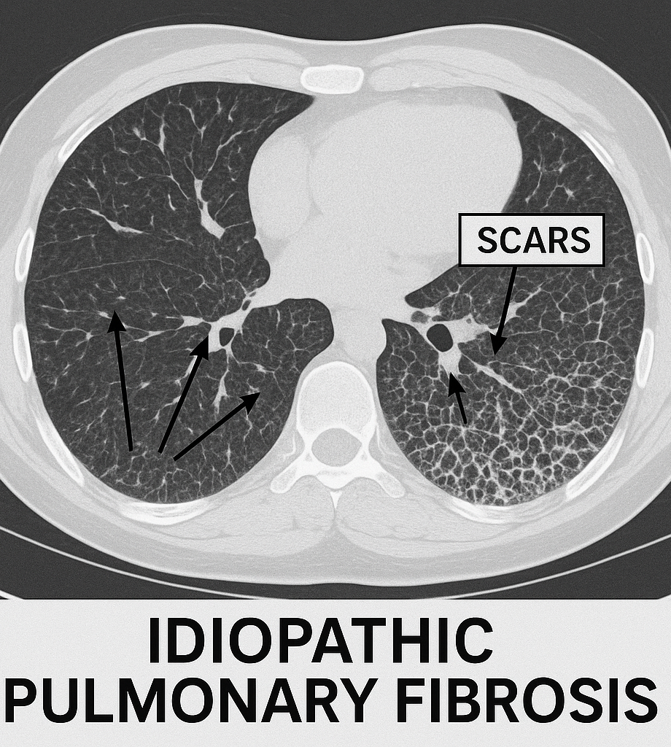
Problem Background
“Idiopathic Pulmonary Fibrosis”
Progressive and irreversible lung disease
Thickening and scarring of lung tissues
Gradual decline in lung function
Symptoms: Shortness of breath, persistent dry cough and fatigue
01

Slide 3
Motivation
The Problem
Our Solution
Positive cases has average life expectancy around 4 years. Early detection is critical, but diagnosing can be time consuming and relies heavily on radiologists.
Automated detection model which can help speed up diagnosis, reduce the burden on radiologists and improve patient outcomes.
02

Slide 4
Main System Requirements
High Accuracy
Robustness to noisy data
The primary requirement for our system is high accuracy, meaning the ability to correctly classify both IPF-positive and IPF-negative CT scans.
Capable of handling noisy data and variations in CT scan quality, which can result from differences in scanner types, patient positioning, and image anomalies.
Scalability
Fast processing speeds
Capable of handling ever-growing datasets, as each patient's IPF CT images are unique and may vary significantly in size, quality, and distribution.
transfer learning – fine tuning will be implemented.
Capable of real-time evaluation, enabling the system to replace manual CT scan analysis and significantly reduce the time required for accurate IPF diagnosis.
03

Slide 5
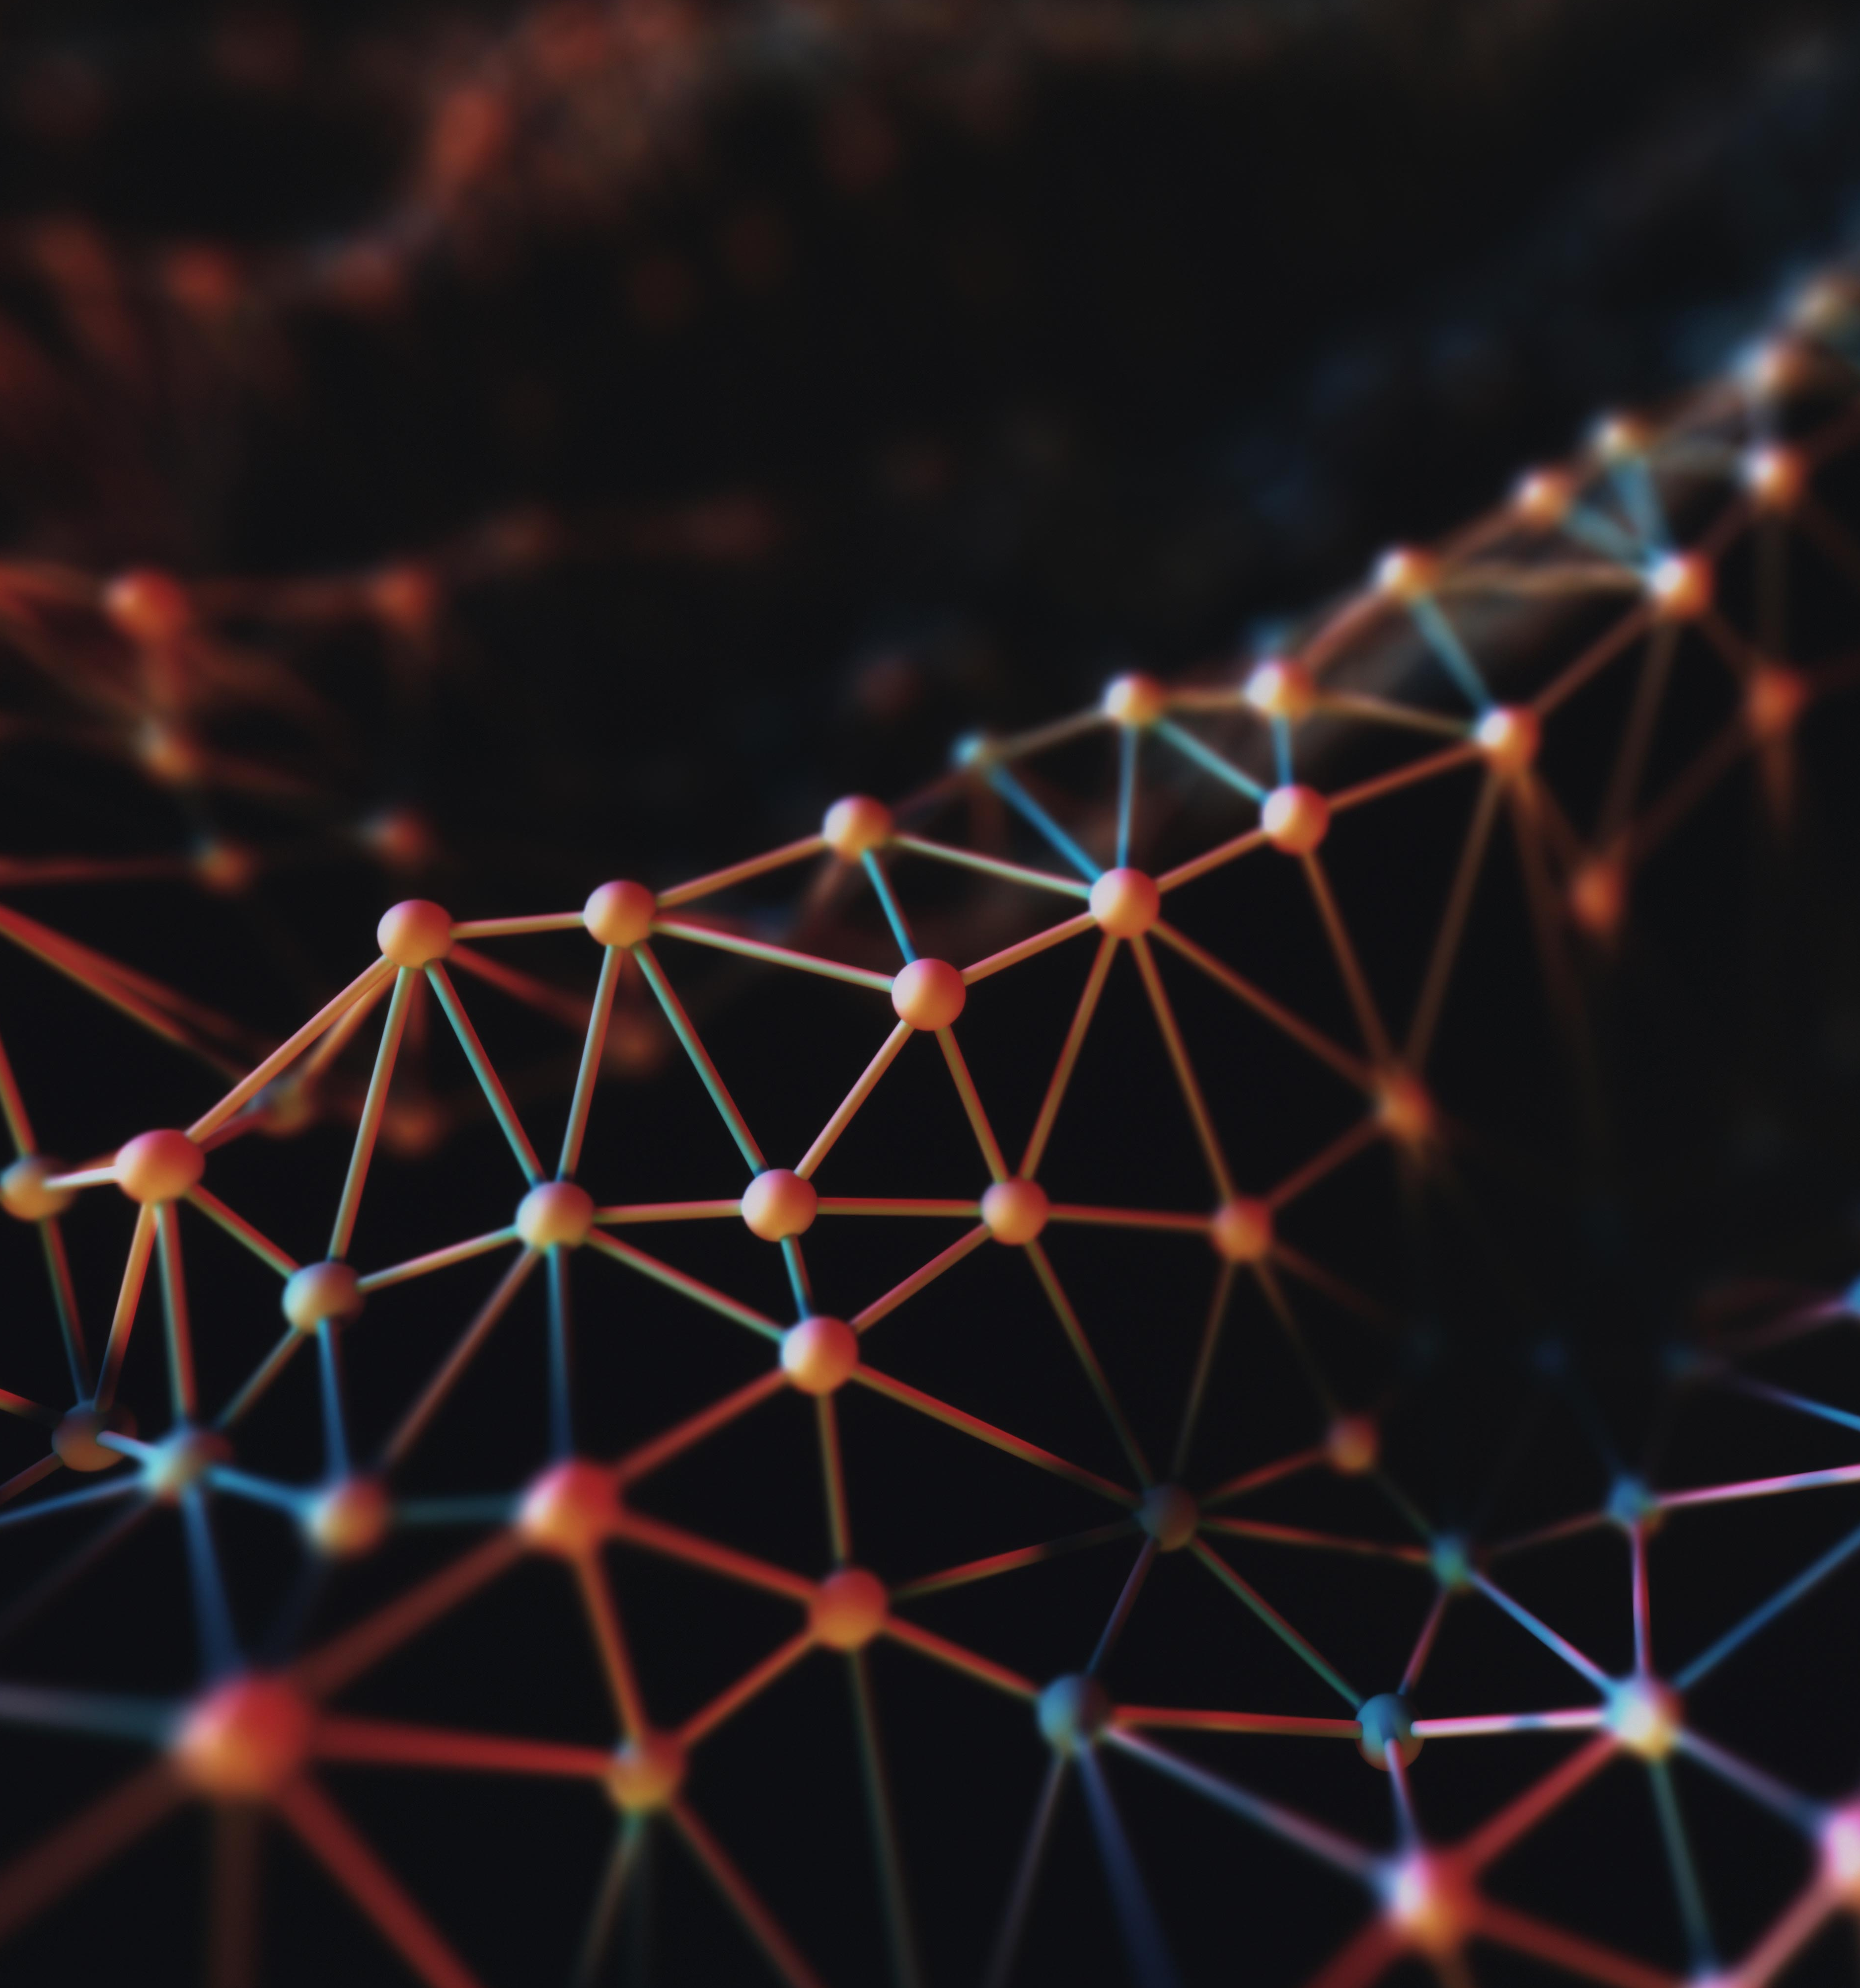
Overview of Our Proposed Solution
Use custom CNN architecture for automated detection
Data augmentation for preventing overfitting and improving generalization
Hyperparameter tuning for optimal performance
04

Slide 6
Key Technologies & Software Tools
Programming Language
Deep Learning Frameworks
Data Processing
Python
TensorFlow, Keras
NumPy, Pandas
Image Processing
Operating System
OpenCV, PIL
Google Colab
05

Slide 7
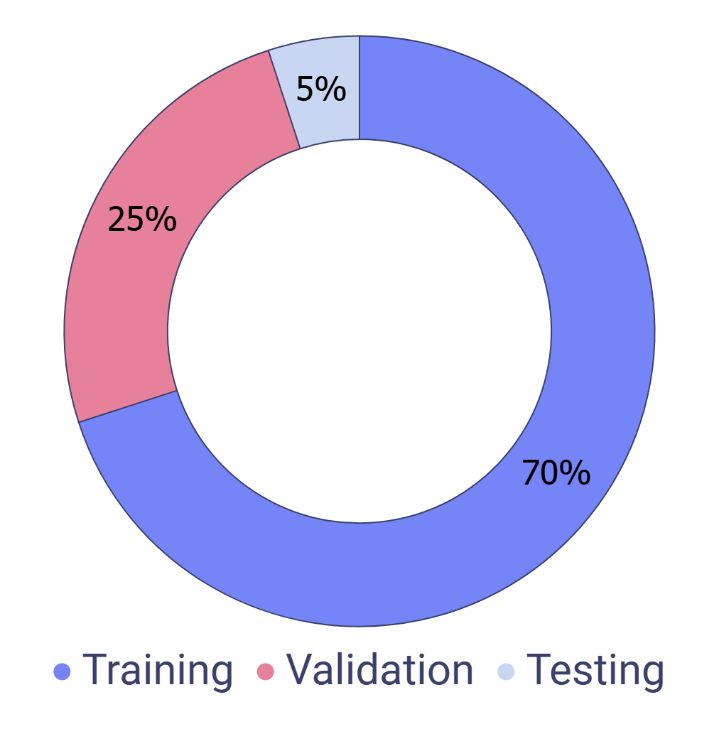
Data Collection & Preprocessing
Dataset:
4,391 CT images 512x512
2,122 IPF Positive
2,269 IPF Negative
Data Split:
Data Augmentation:
Flips
Brightness
contrast
06

Slide 8

Custom CNN Architecture
Softmax Output Layer
Converts the final output to a probability distribution for binary classification
MaxPooling:
Dense Layer
$$S(x_{i})=\frac{e^{x_{i}}}{\sum_{j=1}^{n}{e^{x_{j}}}}$$
Fully connected layer for final decision making
Reduces spatial dimensions to focus on important features
Conv2D Layers:
Flatten Layer:
Dropout Layer:
Extracts feauters from the input
Converts 2D features maps into one dimensional vectors
Reduces overfitting by deactivating random neurons during training
07

Slide 9
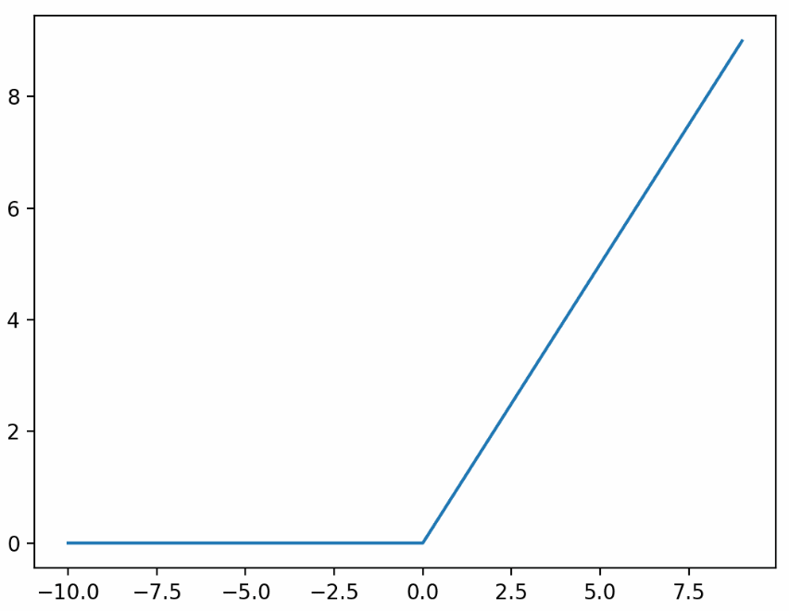
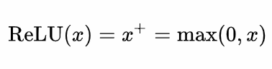
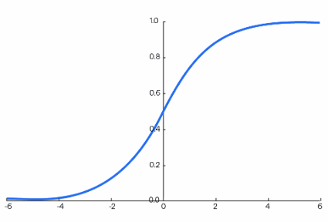
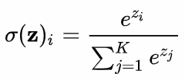
Activation Functions
ReLU
Fast convergence & Prevents vanishing gradient
SoftMax
Probability distribution for binary classification
08

Slide 10
Hyperparameter Tuning
Batch Size
Learning Rate
Dropout Rates
Epochs
32 | 64
5e-4 | 5e-5 | 5e-6
0.3 - 0.5
50 - 150
09

Slide 11
Training & Validation Strategy
To artificially increase the diversity of the training dataset.
Scaling pixel values to a [0, 1] range
Data Augmentation
Normalization
1
4
Defines the number of samples processed before the model weights are updated.
Prevents overfitting by randomly deactivating neurons during training.
Batch Size
Dropout
2
5
3
6
Controls the step size in the weight update during training.
Provides an unbiased evaluation of the model during training.
Learning Rate
Validation Data
10

Slide 12
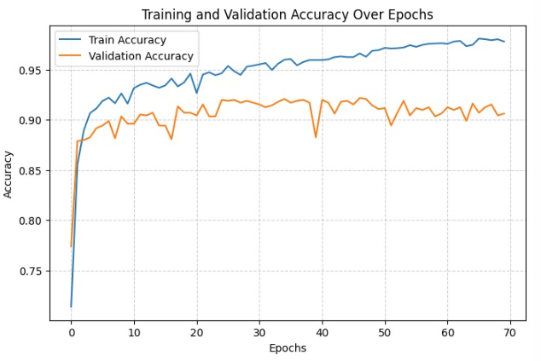
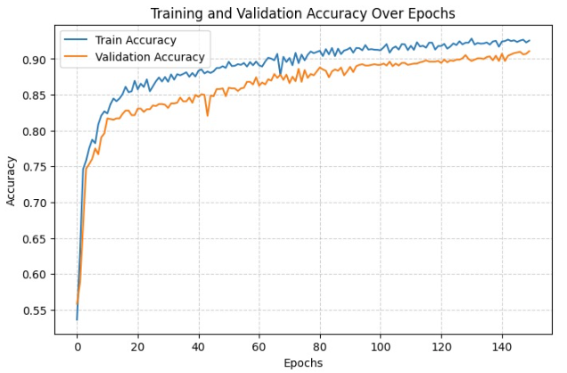


Results – Run Comparision
Run # | Batch Size | Epochs | Learning Rate | Dropout | Augmentation | Test Accuracy | Precision | Recall | F1 Score
1 | 32 | 70 | 5e-5 | 0.3 | No | 0.8318 | 0.8175 | 0.8803 | 0.8477
2 | 32 | 50 | 5e-4 | 0.3 | No | 0.8682 | 0.8438 | 0.9231 | 0.8816
3 | 64 | 150 | 5e-5 | 0.5 | No | 0.8909 | 0.8550 | 0.9573 | 0.9032
4 | 64 | 100 | 5e-6 | 0.5 | Yes | 0.9091 | 0.9619 | 0.8632 | 0.9099
5 | 64 | 150 | 5e-6 | 0.5 | Yes | 0.9227 | 0.9808 | 0.8718 | 0.9231
6 | 64 | 150 | 5e-5 | 0.5 | Yes | 0.9364 | 0.9256 | 0.9573 | 0.9412
7 | 64 | 150 | 5e-6 | 0.45 | Yes | 0.9545 | 0.9652 | 0.9487 | 0.9569
11

Slide 13
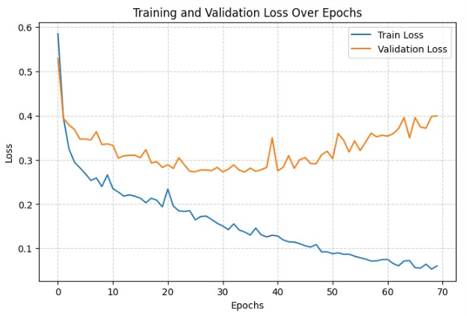
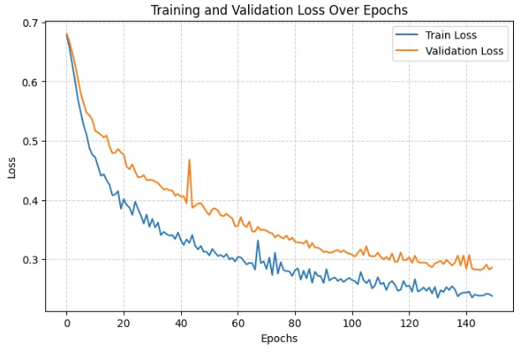
Results – Loss Comparision
Run # | Batch Size | Epochs | Learning Rate | Dropout | Augmentation | Loss
1 | 32 | 70 | 5e-5 | 0.3 | No | 0.4860
2 | 33 | 50 | 5e-4 | 0.3 | No | 0.6690
3 | 64 | 150 | 5e-5 | 0.5 | No | 0.5199
4 | 64 | 100 | 5e-6 | 0.5 | Yes | 0.3345
5 | 64 | 150 | 5e-6 | 0.5 | Yes | 0.2923
6 | 64 | 150 | 5e-5 | 0.5 | Yes | 0.2504
7 | 64 | 150 | 5e-6 | 0.45 | Yes | 0.1964
12

Slide 14
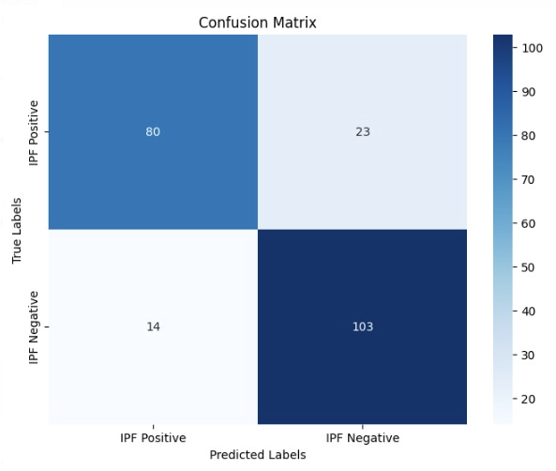
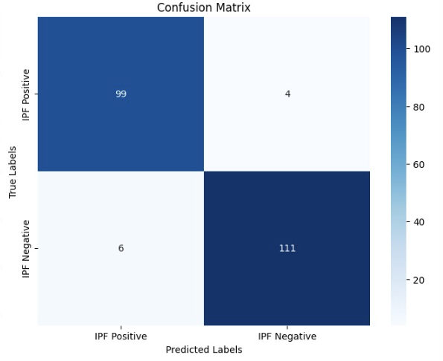
Results - Confusion Matrix & Error Analysis
From 37 to 10 misclassifications out of 220 test samples
FP = 4 & FN = 6
balanced performance for both classes (not bias toward one label)
13

Slide 15
Milestones
IPF Reaserch
Python Adoption
Colab Pro+
Dataset Balancing
Dim → jpg &
RGB → Grayscale
Training Model integration
Hyperparameter Tuning for best results
14

Slide 16
Limitation & Challenges
Data Quality Issues and Dataset size
Hardware Limitations (Colab Memory)
Small dataset size requires extensive data augmentation
Class imbalance can lead to biased models
High memory usage during training
Considered premium Colab subscription for extended sessions
Model Selection
Balancing Precision and Recall
Started with DenseNet121, a deep CNN known for efficient feature reuse and strong gradient flow, which Is better suited for large, diverse datasets and required more computational resources
Switched to a custom CNN for faster training and better performance on smaller, grayscale medical datasets, focused on reducing overfitting with dropout layers and data augmentation
Tuning learning rate, batch size, dropout rate and epochs
Regularly checked the confusion matrix for imbalance
15

Slide 17
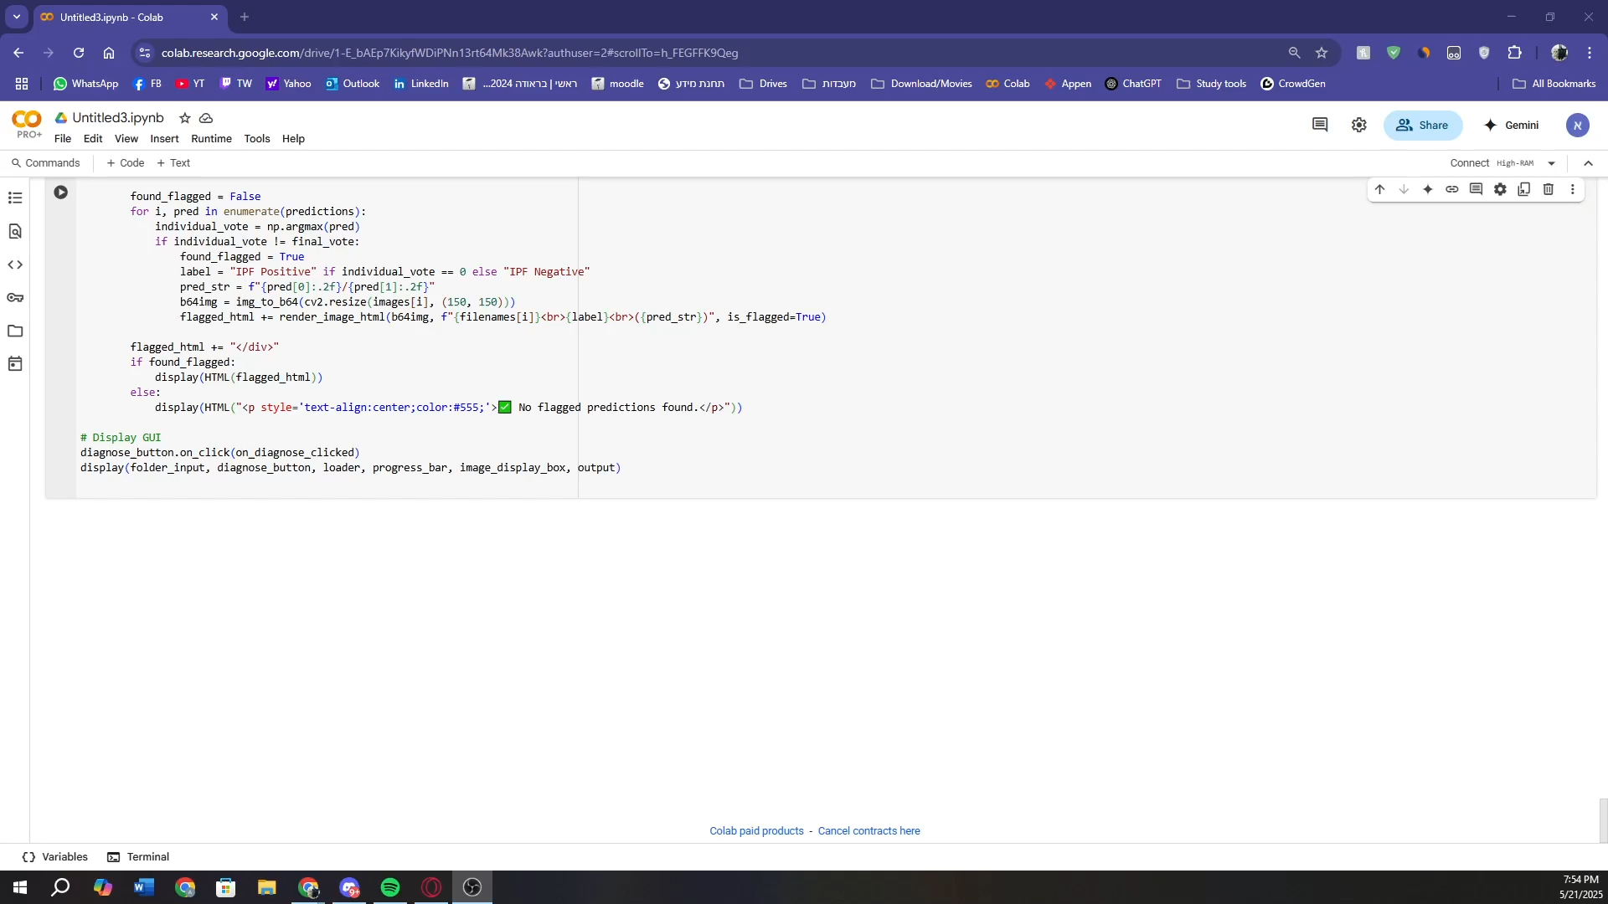
Insert Video
16

Slide 18

Thanks!
Do you have any questions?
Asaf.Schneiderman@e.braude.ac.il
Alex.Baboshin@e.braude.ac.il
17

